Slide 1
History of Historical Biogeography II: Darwin to Models
By Nick Matzke

Slide 2
Common ancestry solved problems
Problems like:
Why no (native) amphibians, terrestrial mammals, earthworms, etc. on remote volcanic islands?
Why do island faunas/floras tend to be a depauperate version of nearby continents?
Why do niches on islands (or isolated continents) seemed to be filled by unusual organisms (unusual, compared to the large continents). (e.g. the kiwi, marsupial lions, etc.)

Slide 3
Darwin & Wallace
Geographical
similarity due
to shared ancestry

Slide 4
Haeckel
Everyone has seen this tree:

Slide 5
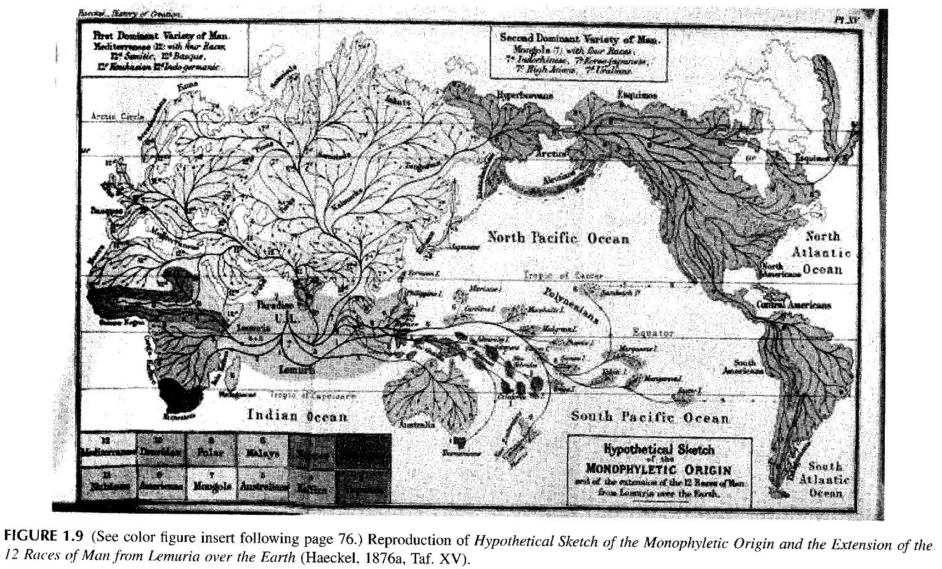
Haeckel
Synthetic biogeographical scenario on a map:

Slide 6
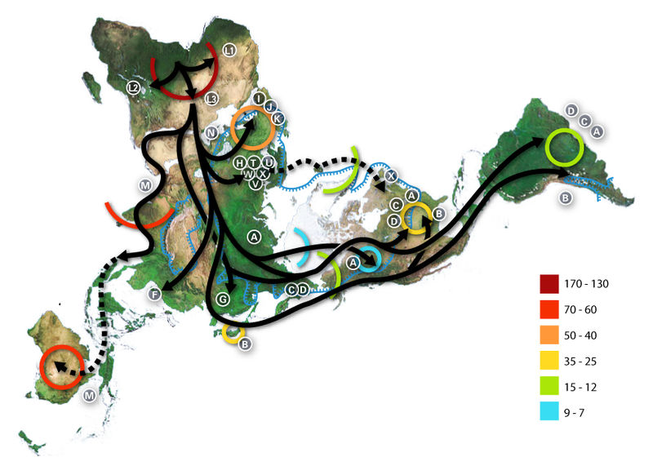
What is historical biogeography?

Slide 7
What is historical biogeography?
Millennia before present
Arrows: general migration path, inferred from mitochondrial DNA Letters: Mitochondria DNA haplotypes
http://en.wikipedia.org/wiki/File:Map-of-human-migrations.jpg

Slide 8
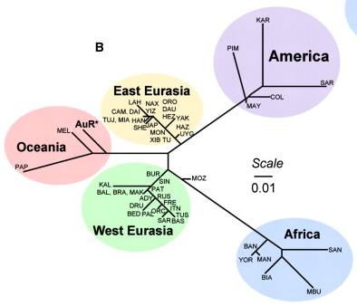
What is historical biogeography?
Dendrogram of genetic distances between human populations
McEvoy et al. (2010), AJHG, Figure 1. Unrooted NJ tree of Fst values derived from allele frequencies. (Note: yes, I know this is a distance tree representing average differences in allele frequencies between populations, not a phylogeny.)

Slide 9
What is historical biogeography?

Slide 10
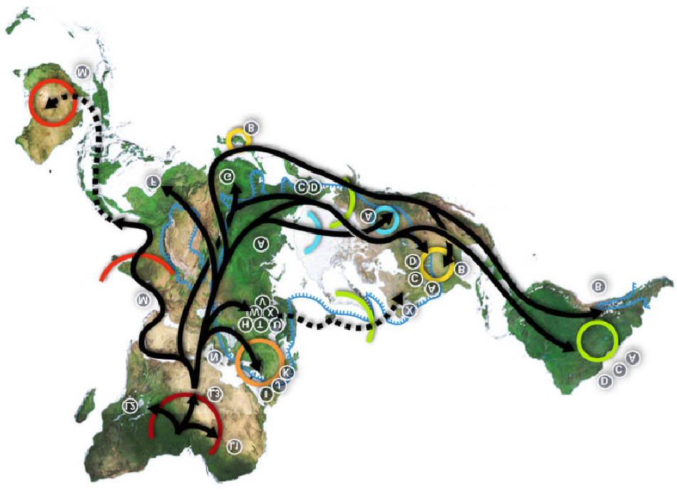
What is historical biogeography?

Slide 11
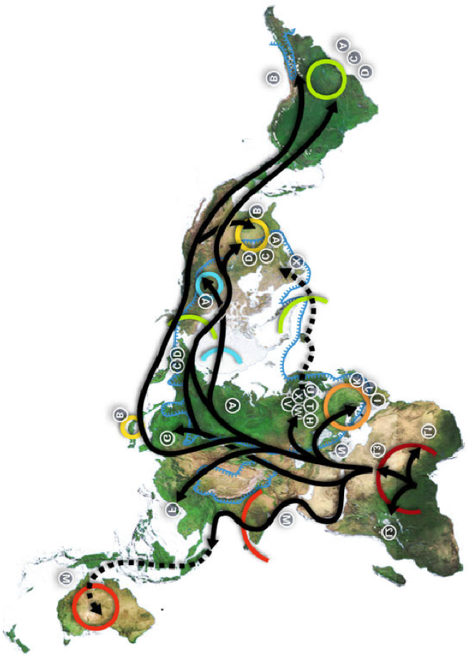
What is historical biogeography?

Slide 12
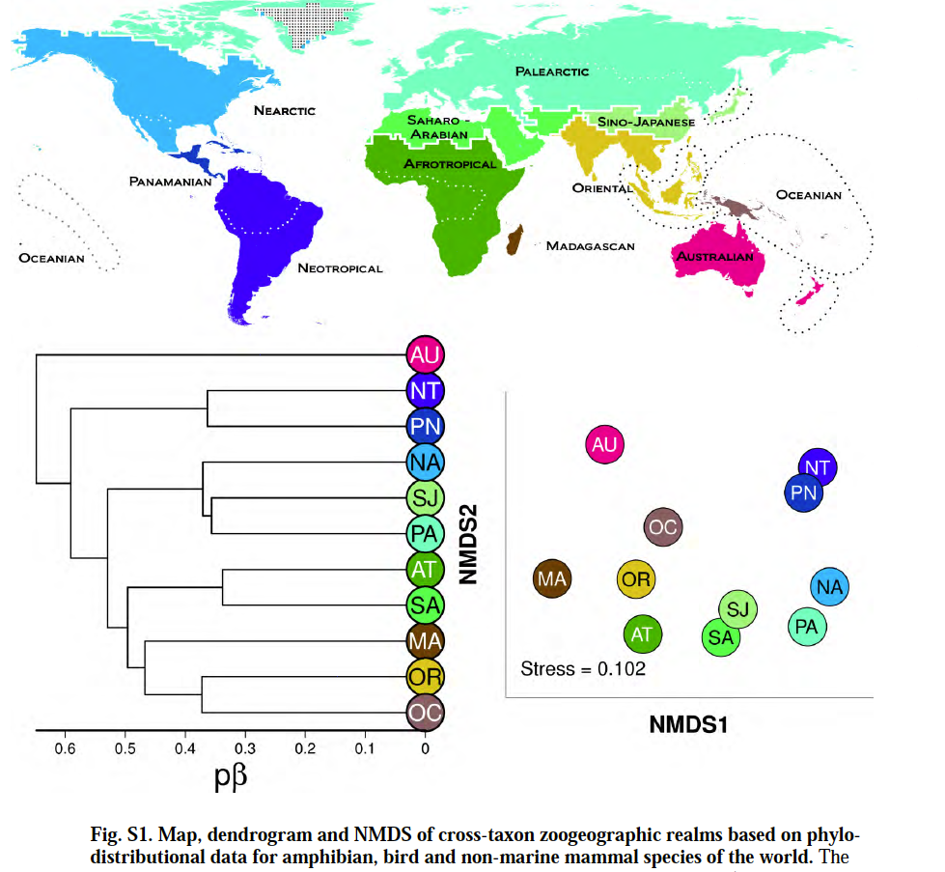
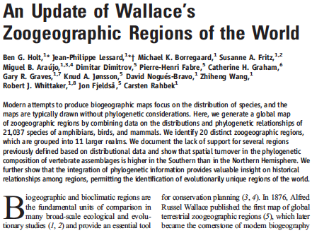
What is historical biogeography?

Slide 13
What is historical biogeography?

Slide 14
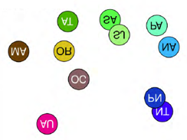
What is historical biogeography?

Slide 15
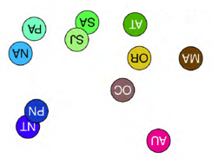
What is historical biogeography?

Slide 16
1859-1950s: “Darwinian” biogeography
Centers of distribution/endemism
Most diversity = center of origin
Delineation of “biogeographical provinces”
Disjunct patterns:
Dispersal
Land bridges
Develop a “synthetic scenario” (i.e. a story)
Darwin to Lyell: land bridges were being created
"as easy as a cook does pancakes."

Slide 17
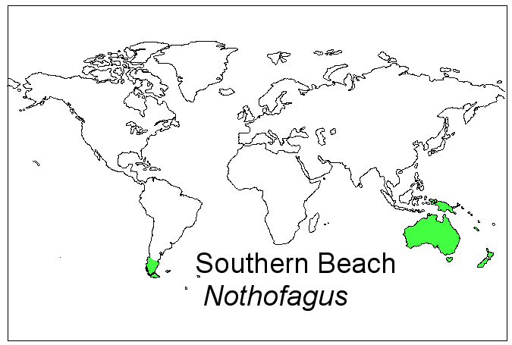
Evolution solved one biogeographical problem, but created new puzzles
Southern Beech
Nothofagus
http://www.geo.arizona.edu/Antevs/ecol438/lect04.html

Slide 18
Evolution solved one biogeographical problem, but created new puzzles
Southern Beech
Nothofagus
http://bioteaching.wordpress.com/2012/03/28/modes-of-speciation/

Slide 19
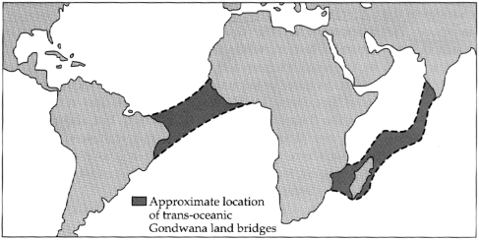
Evolution solved one biogeographical problem, but created new puzzles
Land bridges?
Southern Beech
Nothofagus
http://www.geo.arizona.edu/Antevs/ecol438/lect02.html

Slide 20
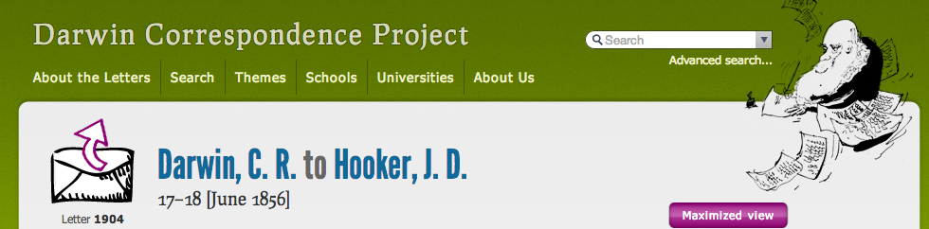
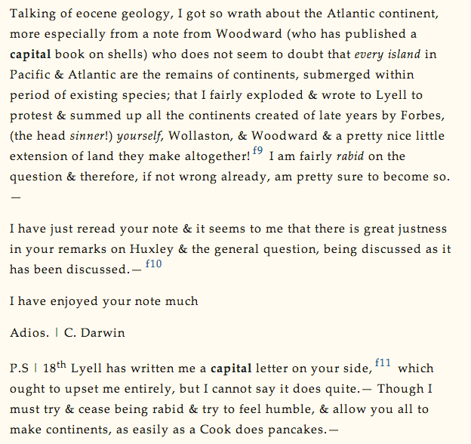
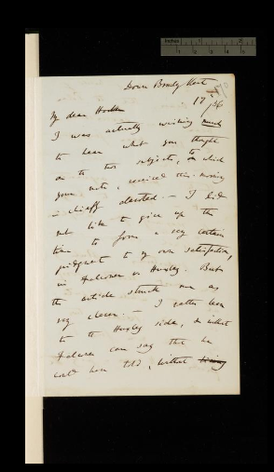
http://www.darwinproject.ac.uk/letter/entry-1904

Slide 21
http://www.darwinproject.ac.uk/letter/entry-1904

Slide 22
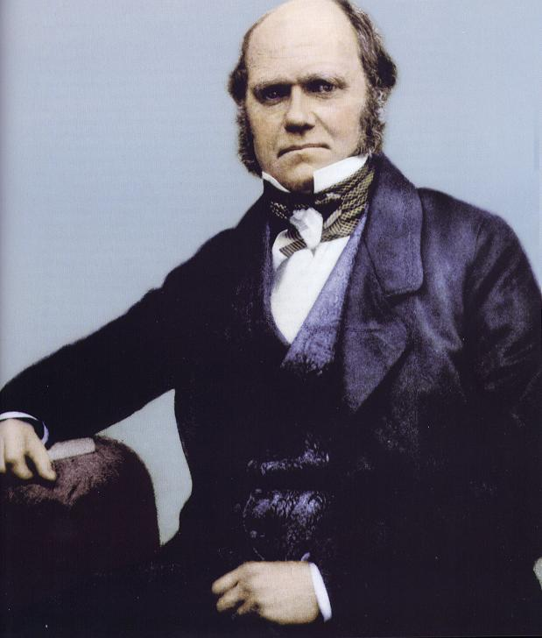
“I must try & cease being rabid & try to feel humble, & allow you all to make continents, as easily as a Cook does pancakes.”
-- Darwin to Hooker, June 1856
http://www.darwinproject.ac.uk/letter/entry-1904

Slide 23
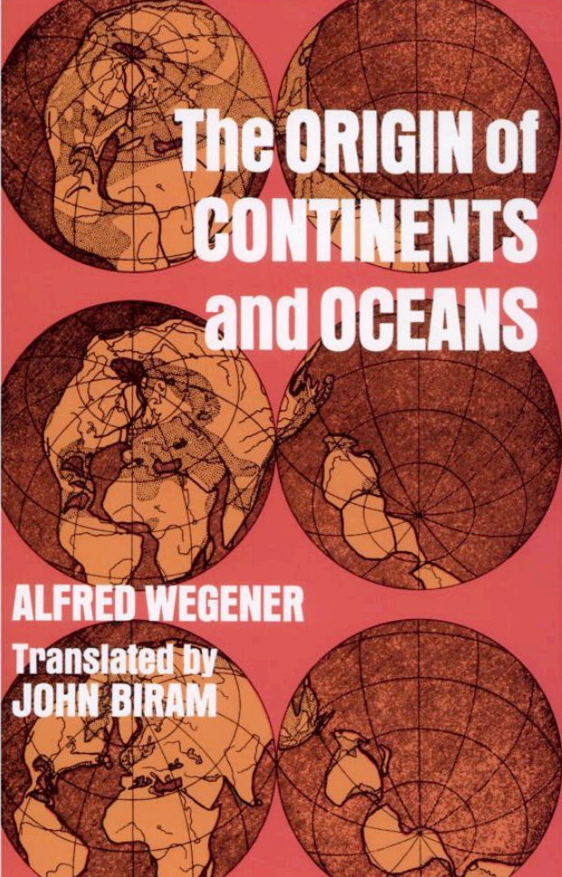
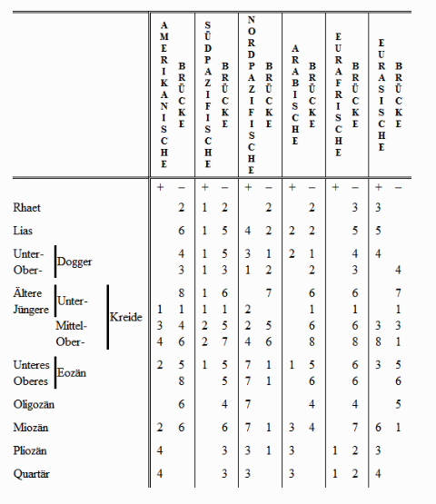
Wegener, continental drift

Slide 24
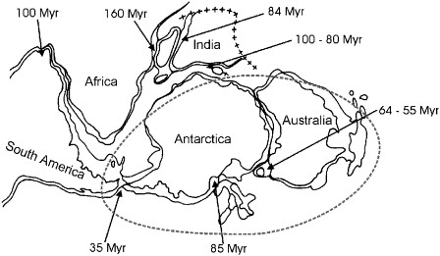
Plate tectonics led many to favor vicariance
Southern Beech
Nothofagus
Posadasa et al. (2006). "Historical biogeography: A review of its basic concepts and critical issues." Journal of Arid Environments, 66(3), 389–403.

Slide 25
1950s-1980s: panbiogeography
Look for “tracks” connecting members of a taxon; look for shared patterns in tracks
Leon Croizat
anti-dispersalist
focused on pattern rather than process
polemical & ideological
taxonomy- rather than phylogenetically based; huge polyphyly/paraphyly problems
seen by some to support plate tectonics

Slide 26
1950s-1980s: panbiogeography
Methodology unclear…
Croizat’s summary diagram of global tracks from his (1958) Panbiogeography

Slide 27
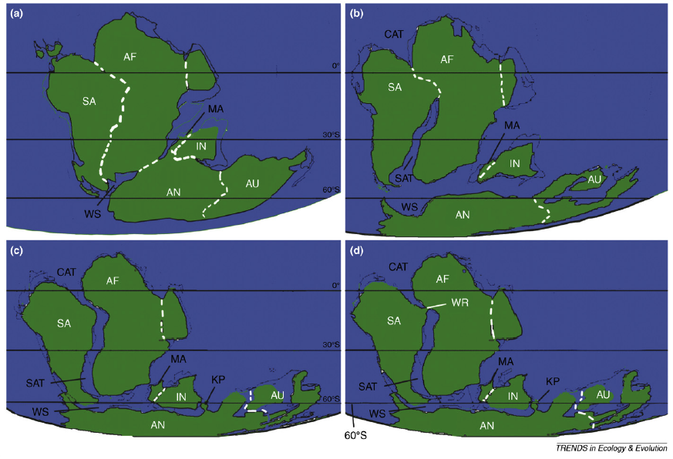
1960s-1990s: plate tectonics & cladistic biogeography
Different scenarios for breakup of Gondwanaland

Slide 28
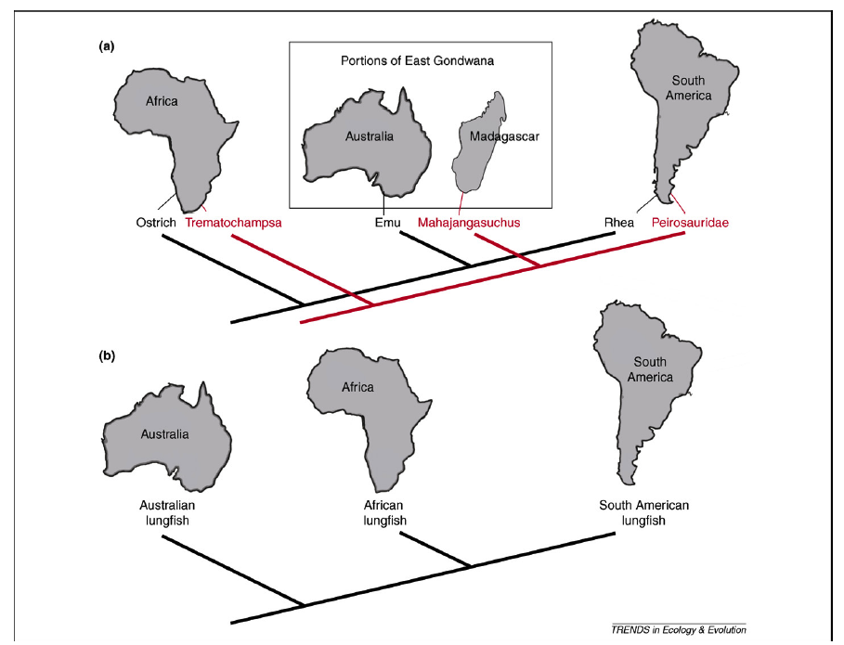
1960s-1990s: plate tectonics & cladistic biogeography

Slide 29
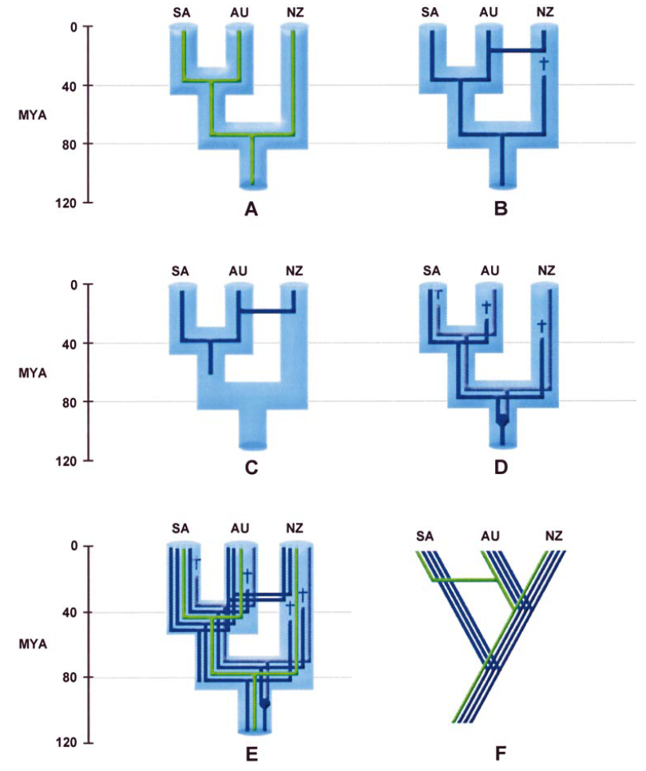
1960s-1990s: plate tectonics & cladistic biogeography
Donoghue & Moore (2003)

Slide 30
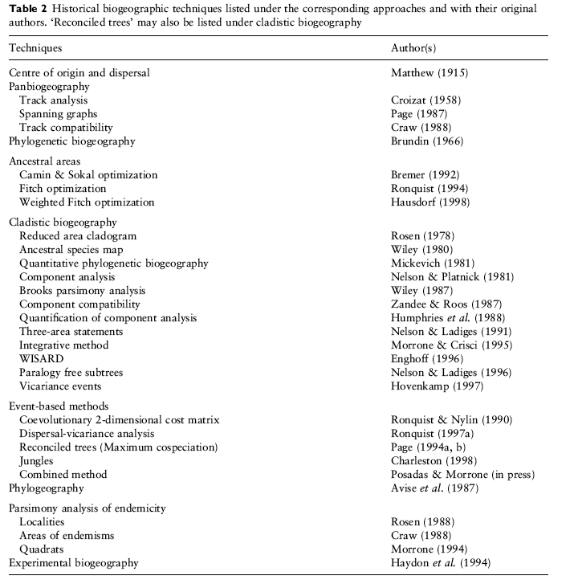
1980s-2000s: diversity of methods in use

Slide 31
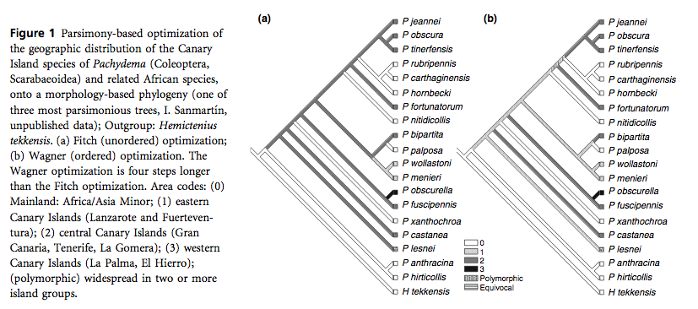
1980s-2000s: parsimony methods

Slide 32
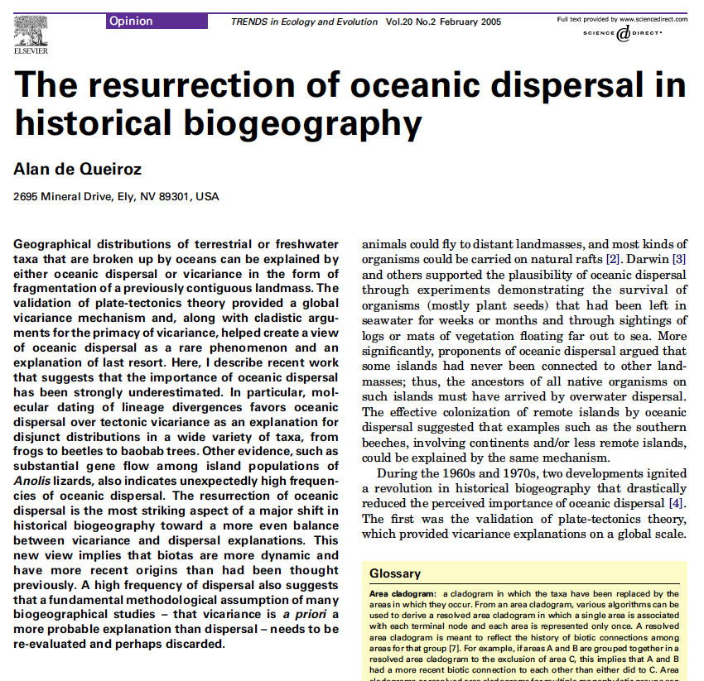
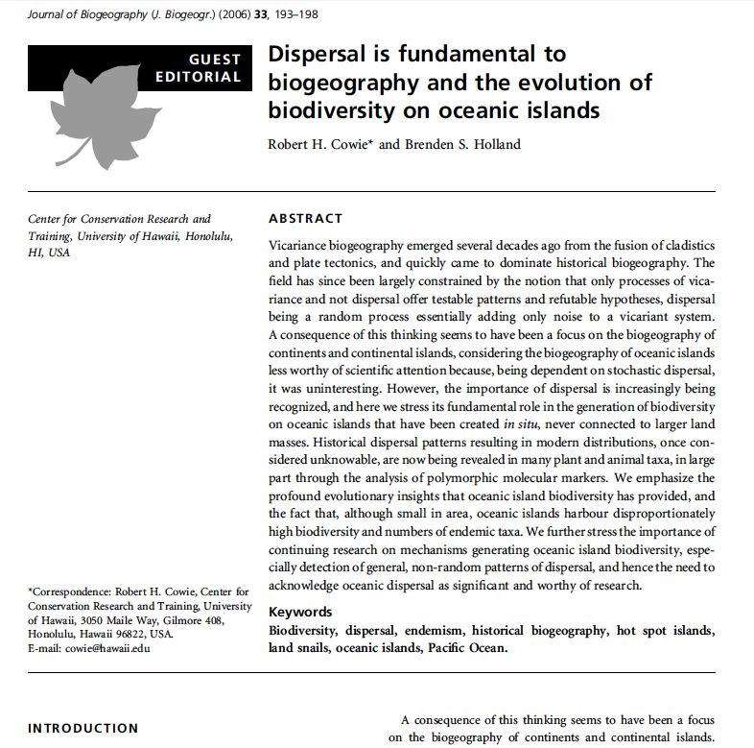
Dispersal versus Vicariance
“A high frequency of dispersal also suggests that a fundamental methodological assumption of many biogeographical studies -- that vicariance is a priori a more probable explanation than dispersal -- needs to be re-evaluated and perhaps discarded."
de Queiroz, A. (2005). "The resurrection of oceanic dispersal in historical biogeography." TREE, 20(2).
“We hope, therefore, that the trend identified by de Queiroz (2005) – the resurrection of oceanic dispersal as important in historical biogeography – is real and that the straightjacket of strict vicariance biogeography is being loosened to include once again the plurality of mechanisms and processes..."
p. 197 of: Cowie, R.H.; Holland, B.S. (2006). "Dispersal is fundamental to biogeography and the evolution of biodiversity on oceanic islands." Journal of Biogeography, 33, 193-198. Emphasis added.

Slide 33
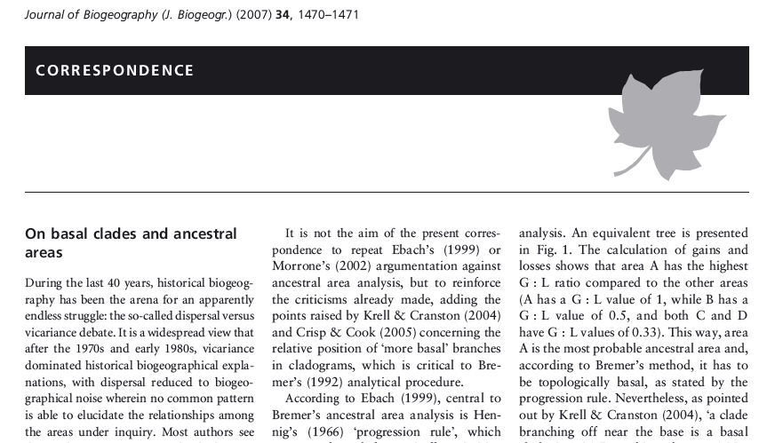
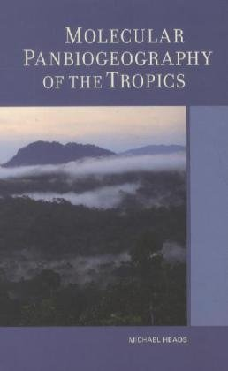
Dispersal versus Vicariance
“During the last 40 years, historical biogeography has been the arena for an apparently endless struggle: the so-called dispersal versus vicariance debate.”
“The resurrection of dispersalism, as de Queiroz (2005) has envisioned, is reactionary and with little (or even no) empirical foundation.” Santos, C.M.D. (2007). “On basal clades and ancestral areas.” Journal of Biogeography, 34, 1470-1469.
“Most modern biogeographers follow Mayr...in accepting that allopatry can be found by vicariance (dichopatry) or by founder dispersal (peripatry), but only vicariance is accepted here.”
“founder dispersal...is controversial and may not exist.”
p. 15 in: Heads, M.J. (2012) Molecular panbiogeography of the tropics. University of California Press, Berkeley, CA.

Slide 34
Summary: dispersal versus vicariance

Slide 35

Summary: dispersal versus vicariance

Slide 36
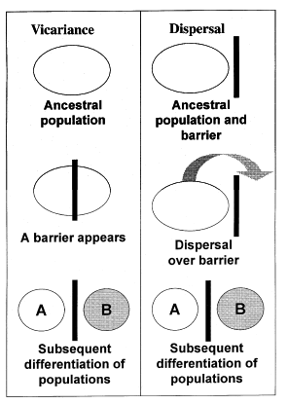
2000s: event-based methods
DIVA -- DIspersal/Vicariance Analysis -- Ronquist (1997)
derived from host/parasite cophylogeny etc.
cost of 1 assigned to dispersal & extinction
cost of 0 to vicariant speciation

Slide 37
A
BC
B
C
A
BC
B
C
N=number of areas
E.g., if N=3 areas:
Areas = A, B, C
Number of ranges = 2^{N}-1
= 7 possible ranges:
1. Null (excluded)
2. A
3. B
4. C
5. AB
6. AC
7. BC
8. ABC
(B)
(C)
(BC)
BC
BC
This distribution of
areas:
(A)
(BC)
Can be explained with 0 cost…
ABC
A
BC
B
A
A
BC
B
A
(B)
(A)
(BC)
AB
<======== A added
<======== C extirpated
BC
(A)
(BC)
But this distribution of
areas:
Requires one of several scenarios, e.g…
ABC

Slide 38
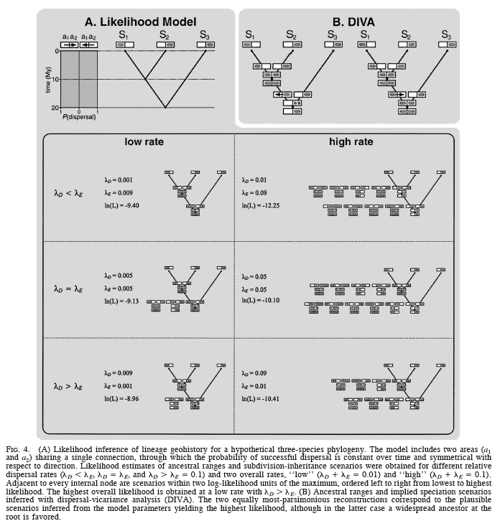
2005: Maximum Likelihood
Implemented in:
AReA

Slide 39
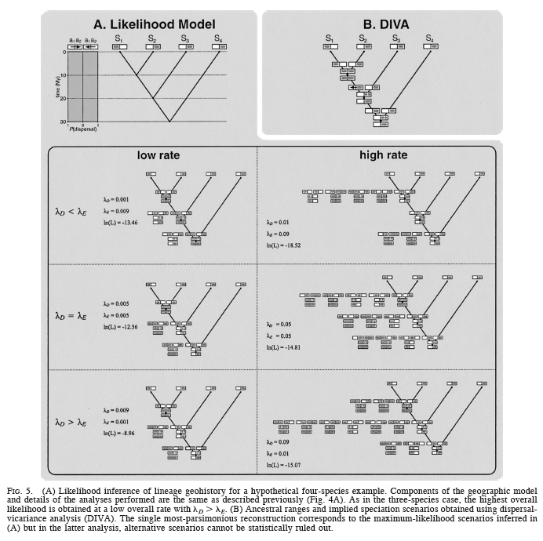
2005: Maximum Likelihood
Implemented in:
AReA

Slide 40
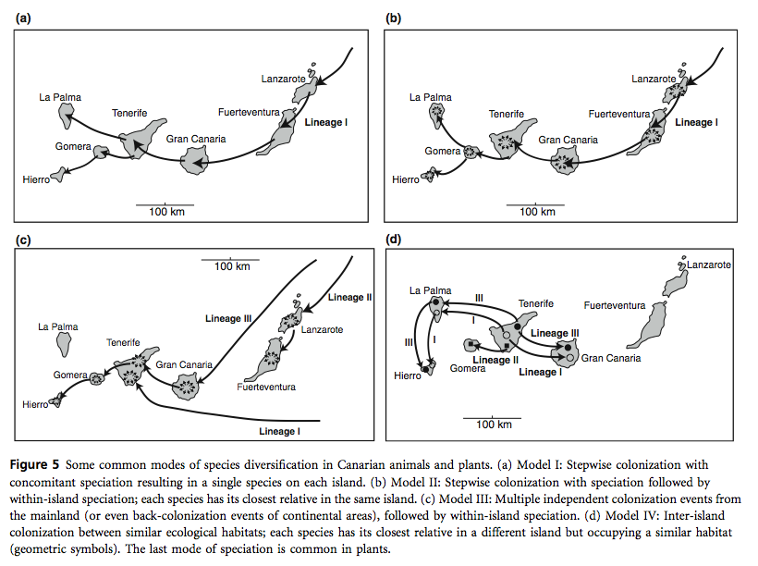
2008: First Bayesian method
Example: Canary Islands biogeography

Slide 41
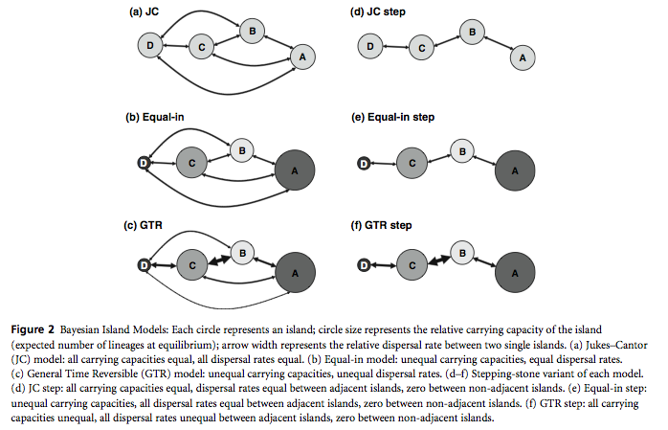
2008: First Bayesian method
Sanmartin et al. (2008), MrBayes4

Slide 42
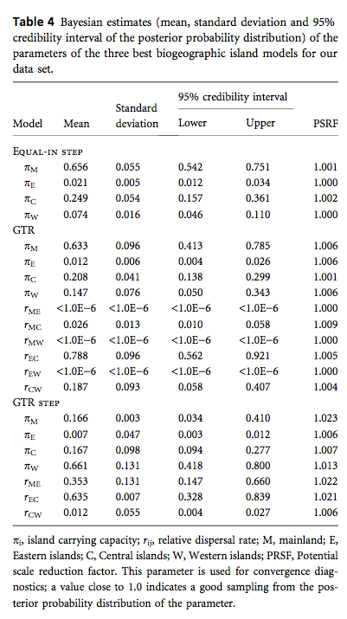
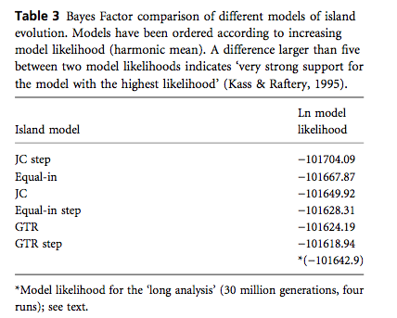
2008: First Bayesian method
Sanmartin et al. (2008), MrBayes4

Slide 43
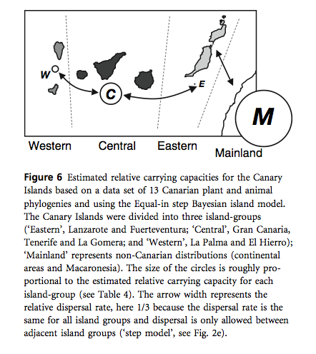
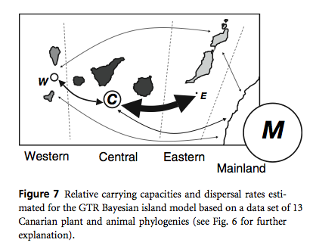
2008: First Bayesian method
Sanmartin et al. (2008), MrBayes4

Slide 44
Critique of available methods
tend to be “box models”
how to deal with multiple ancestral areas?
not spatially explicit
limited number of areas
sometimes comparative analyses run; few simulation attempts (unlike many other fields)

Slide 45
Pause; then:
Review of assumptions of main Event-Based Methods

Slide 46
Historical biogeography methods make strong assumptions
1. Take a phylogeny
2. Put the geographic ranges at the tips
3. Assume some process(es)
4. Conduct inference
(less important: under parsimony, ML, or Bayesian)

Slide 47
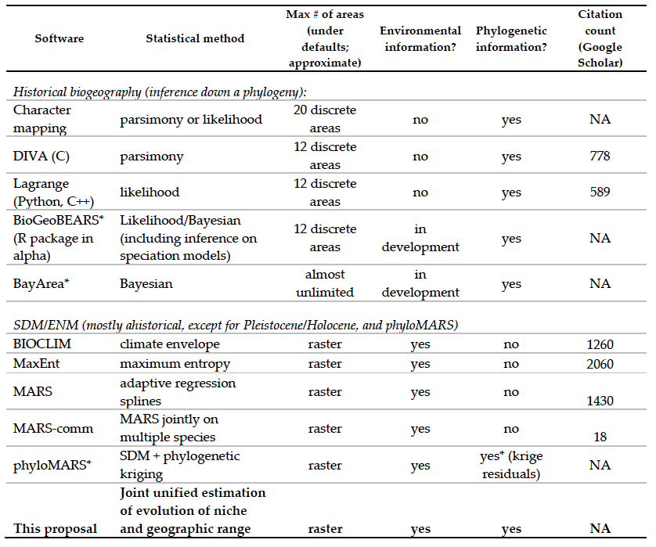
Main Event-Based Methods

Slide 48
Main Event-Based Methods
Method #1: Treat biogeography as any other discrete character
Method #2: DIVA (Dispersal-Vicariance Analysis) -- Ronquist (1997)
Method #3: LAGRANGE (Likelihood Analysis of Geographic Range Evolution) - Dispersal-Extinction Cladogenesis (DEC)
Method #4: BayArea - Bayesian sampling

Slide 49
Event-based method #1
Treat biogeography as any other discrete character
Guzman B, Vargas P (2009). "Historical biogeography and character evolution of Cistaceae (Malvales) based on analysis of plastid rbcL and trnL-trnF sequences." Organisms, Diversity & Evolution 9, 83–99.

Slide 50
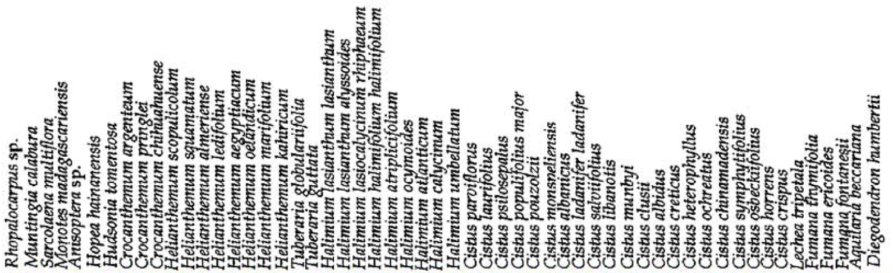
Event-based method #1
Treat biogeography as any other discrete character
Guzman B, Vargas P (2009). "Historical biogeography and character evolution of Cistaceae (Malvales) based on analysis of plastid rbcL and trnL-trnF sequences." Organisms, Diversity & Evolution 9, 83–99.

Slide 51
Event-based method #1:
Standard character
Assumed model: instantaneous complete range-switching
ancestor:
descendant:
A
B

Slide 52
Event-based method #1:
Standard character
Assumed model: instantaneous complete range-switching
ancestor:
descendant:
A
B
range A suddenly converts to range B

Slide 53
Event-based method #1:
Standard character
Assumed model: instantaneous complete range-switching
Rate or cost matrix:
ancestor:
descendant:
 | A | B | C | D
A | - | a | a | a
B | a | - | a | a
C | a | a | - | a
D | a | a | a | -
A
B
range A suddenly converts to range B
a = rate (or cost) of transition

Slide 54
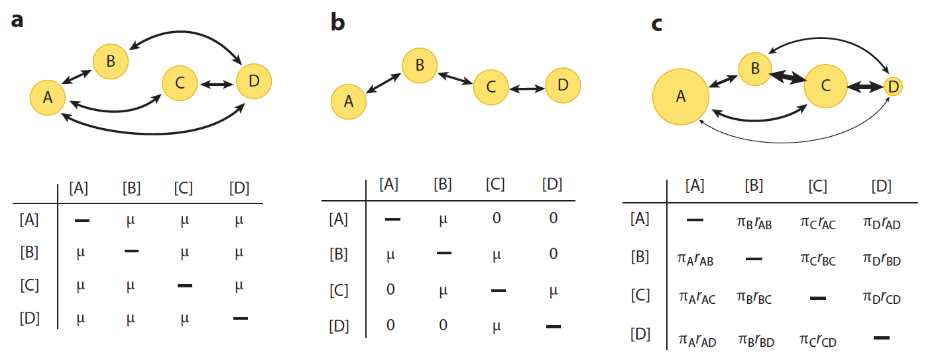
Event-based method #1:
Standard character
Assumed model: instantaneous complete range-switching
Ronquist F, Sanmartin I (2011). "Phylogenetic Methods in Biogeography." Annu Rev Ecol Evol Syst. 2011. 42:441–64

Slide 55
Event-based method #2:
DIVA: Dispersal-vicariance analysis (Ronquist 1997)
Lineages are allowed to live in all of the areas areas: A, B, C ranges could be: A, B, C, AB, BC, AC, ABC)
Ronquist F, Sanmartin I (2011). "Phylogenetic Methods in Biogeography." Annu Rev Ecol Evol Syst. 2011. 42:441–64

Slide 56
Event-based method #2:
DIVA: Dispersal-vicariance analysis
Dispersal and extinction events (along branches) have cost 1:
A => AB (“dispersal” event) AB => B (“extinction” event)
Ronquist F, Sanmartin I (2011). "Phylogenetic Methods in Biogeography." Annu Rev Ecol Evol Syst. 2011. 42:441–64

Slide 57
Event-based method #2:
DIVA: Dispersal-vicariance analysis
Ronquist F, Sanmartin I (2011). "Phylogenetic Methods in Biogeography." Annu Rev Ecol Evol Syst. 2011. 42:441–64

Slide 58
Event-based method #2:
DIVA: Dispersal-vicariance analysis
Vicariance events (at speciation) have cost 0: AB => A, B
Ronquist F, Sanmartin I (2011). "Phylogenetic Methods in Biogeography." Annu Rev Ecol Evol Syst. 2011. 42:441–64

Slide 59
Event-based method #2:
DIVA: Dispersal-vicariance analysis
Ronquist F, Sanmartin I (2011). "Phylogenetic Methods in Biogeography." Annu Rev Ecol Evol Syst. 2011. 42:441–64

Slide 60
Event-based method #2:
DIVA: Dispersal-vicariance analysis
Ronquist F, Sanmartin I (2011). "Phylogenetic Methods in Biogeography." Annu Rev Ecol Evol Syst. 2011. 42:441–64

Slide 61
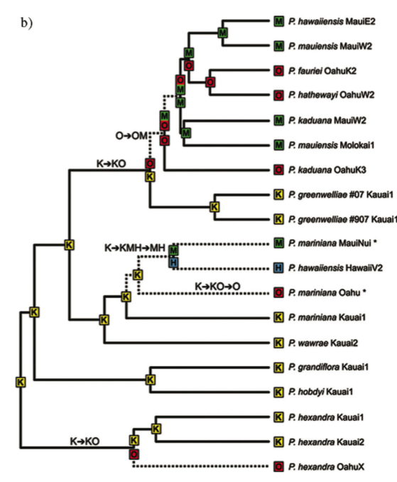
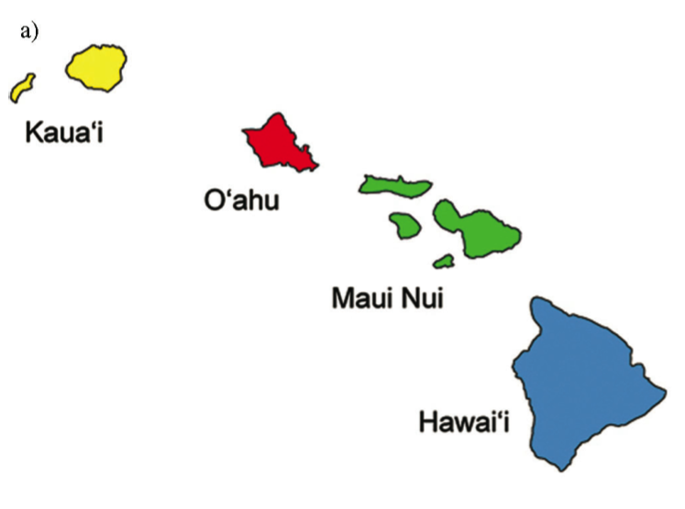
Event-based method #3:
DEC: Dispersal-extinction cladogenesis
Program: “LAGRANGE”
e.g., Ree & Smith (2008) Hawaiian Psychotria

Slide 62
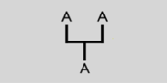
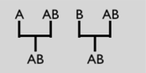
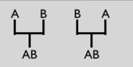
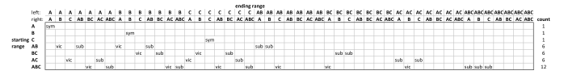
Event-based method #3:
DEC: Dispersal-extinction cladogenesis
Cladogenesis -- range evolution at speciation events (LAGRANGE model)
Weights per speciation event:
sympatric
subset
vicariance

Slide 63
Event-based method #3:
DEC: Dispersal-extinction cladogenesis
d = “dispersal” = range extension
e = “extinction” = range loss
cladogenesis process
Implemented in the program LAGRANGE
(Likelihood Analysis of Geographic RANGe Evolution)
by Rick Ree & Stephen Smith (2008)

Slide 64
DEC: Dispersal-extinction cladogenesis
+B
“dispersal” event
(really, range expansion)
A
AB
“extinction” event
(really, extirpation or range contraction)
-B
AB
A

Slide 65
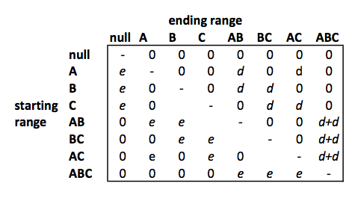
DEC: Dispersal-extinction cladogenesis
d = “dispersal” = range extension
e = “extinction” = range loss
Instantaneous rate matrix:

Slide 66
DEC: Dispersal-extinction cladogenesis
Cladogenesis -- range evolution at speciation events
Sympatric
speciation
(range
duplication)
Sympatric
speciation
(subset)
Vicariant
speciation
(range
division)

Slide 67
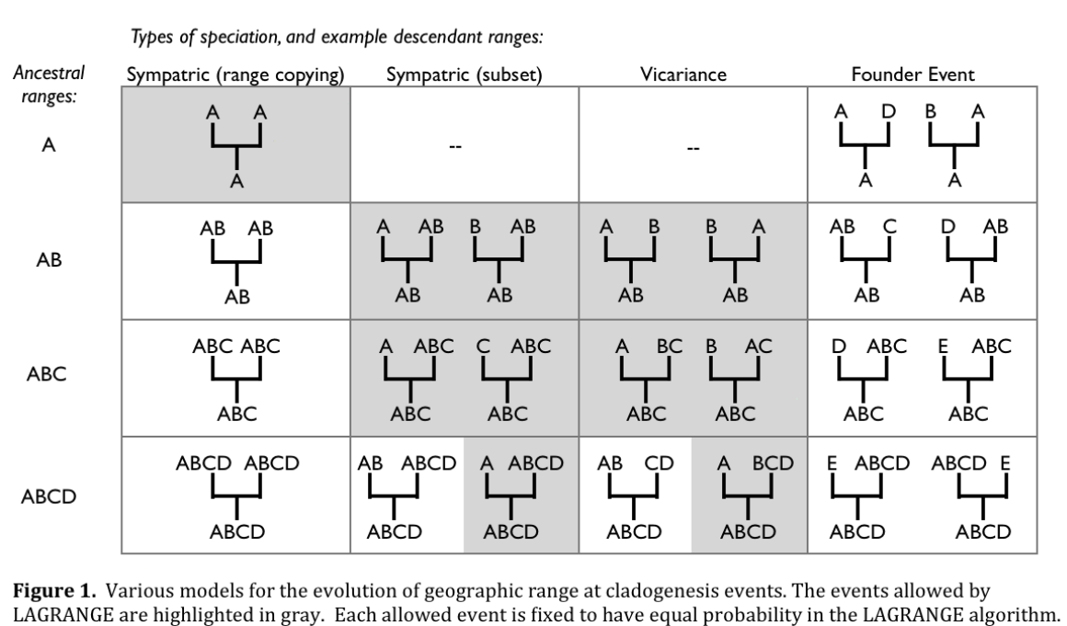
LAGRANGE has a fixed speciation model (grey areas below)

Slide 68
DEC: Dispersal-extinction cladogenesis
Cladogenesis -- range evolution at speciation events (LAGRANGE model)
Probabilites per speciation event:
sympatric
subset
vicariance
LAGRANGE: all events equiprobable

Slide 69
Event-based method #2:
DIVA: Dispersal-vicariance analysis
Ronquist F, Sanmartin I (2011). "Phylogenetic Methods in Biogeography." Annu Rev Ecol Evol Syst. 2011. 42:441–64

Slide 70
Event-based method #2:
DIVA: Dispersal-vicariance analysis
Ronquist F, Sanmartin I (2011). "Phylogenetic Methods in Biogeography." Annu Rev Ecol Evol Syst. 2011. 42:441–64

Slide 71
Event-based method #3:
DEC: Dispersal-extinction cladogenesis
Program: “LAGRANGE”
e.g., Ree & Smith (2008) Hawaiian Psychotria

Slide 72
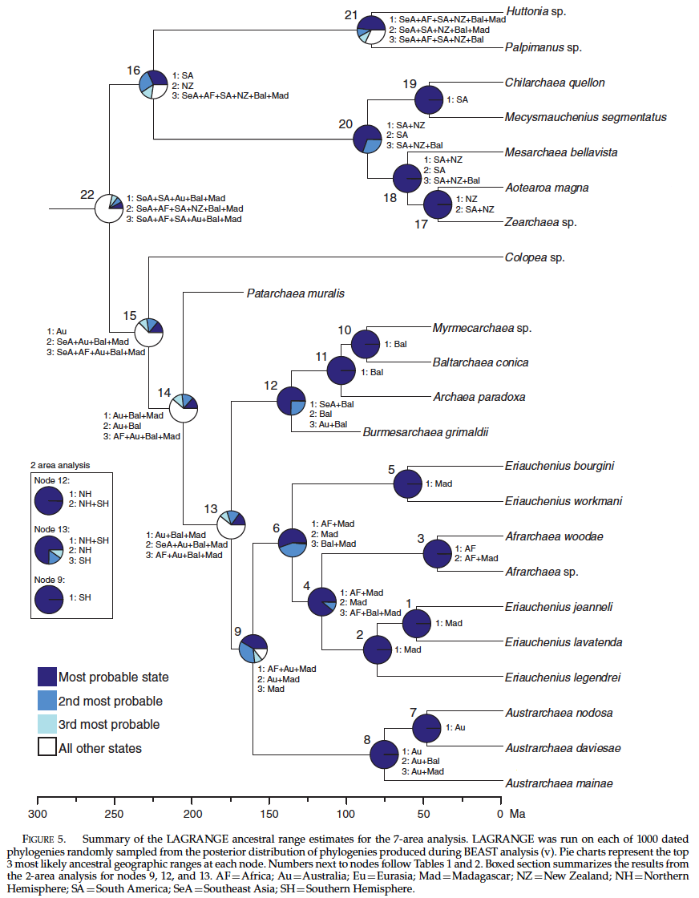
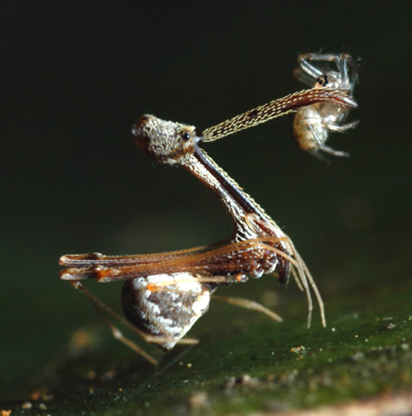
“State-of-the-art analysis”
Bayes-LAGRANGE
Assassin spider biogeography
Wood, HM; Matzke, NJ; Gillespie, RG; Griswold, CE (2012). "Treating Fossils as Terminal Taxa in Divergence Time Estimation Reveals Ancient Vicariance Patterns in the Palpimanoidea Spiders." Systematic Biology, 62(2), 264-284.

Slide 73
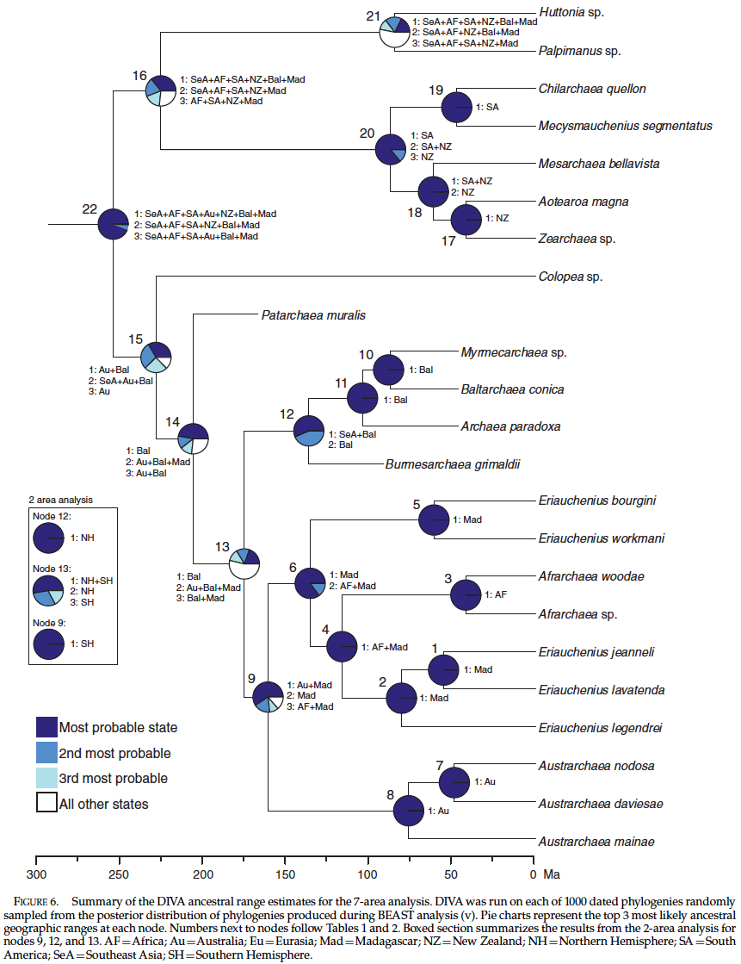
Assassin spider biogeography
“State-of-the-art analysis”
Bayes-DIVA
Wood, HM; Matzke, NJ; Gillespie, RG; Griswold, CE (2012). "Treating Fossils as Terminal Taxa in Divergence Time Estimation Reveals Ancient Vicariance Patterns in the Palpimanoidea Spiders." Systematic Biology, 62(2), 264-284.

Slide 74
Problems with the state-of-the-art analysis
Complete range data is assumed
“true” vicariance is not allowed
new species always start out at rangesize=1
Species always start inside their ancestral range
In LAGRANGE, this cladogenesis model is fixed and unchangeable

Slide 75

Event-based method #4: BayArea
Bayesian sampling of histories
Biogeographic rate matrices rapidly get huge (2^{number of areas})
See “BayArea” program: http://code.google.com/p/bayarea
Accepted, Systematic Biology
Can do hundreds of areas through Bayesian data augmentation
But, assumes ranges are copied at cladogenesis

Slide 76

Event-based method #4: BayArea
“BayArea” program (Landis et al. 2013)
Cladogenesis -- “no event” during speciation (i.e., pure continuous time)
“Sympatric” (range-copying) speciation occurs with probability=1.0
Weights per speciation event:

Slide 77

Different cladogenesis models!

Slide 78
Different cladogenesis models!

Slide 79
Unresolved fundamental issues
What is the right model?
“Vicariance vs. dispersal”
Range extension / contraction
Cladogenic vs. anagenic change
Founder-event speciation

Slide 80
Unresolved fundamental issues
What is the right model?
“Vicariance vs. dispersal”
Range extension / contraction
Cladogenic vs. anagenic change
Founder-event speciation

Slide 81
Founder-event speciation
Founder-event speciation
In founder-event speciation, a rare dispersal event “instantaneously” establishes a geographically isolated new lineage with one or a few individuals
Widely discussed in population genetics, speciation literature, island biogeography
However, was ignored in historical biogeography computational inference models

Slide 82
LAGRANGE has a fixed speciation model (grey areas below)

Slide 83
(remember?) Dispersal versus Vicariance
“During the last 40 years, historical biogeography has been the arena for an apparently endless struggle: the so-called dispersal versus vicariance debate.”
“The resurrection of dispersalism, as de Queiroz (2005) has envisioned, is reactionary and with little (or even no) empirical foundation.” Santos, C.M.D. (2007). “On basal clades and ancestral areas.” Journal of Biogeography, 34, 1470-1469.
“Most modern biogeographers follow Mayr...in accepting that allopatry can be found by vicariance (dichopatry) or by founder dispersal (peripatry), but only vicariance is accepted here.”
“founder dispersal...is controversial and may not exist.”
p. 15 in: Heads, M.J. (2012) Molecular panbiogeography of the tropics. University of California Press, Berkeley, CA.

Slide 84

Let’s think outside the box!
http://www.snorgtees.com/think-outside-the-box

Slide 85
Let’s think outside the box!

Slide 86
Let’s think outside the box!

Slide 87
DEC: Dispersal-extinction cladogenesis
Cladogenesis -- range evolution at speciation events (LAGRANGE model)
Probabilites per speciation event:
sympatric
subset
vicariance
LAGRANGE: all events equiprobable

Slide 88

DECj: Dispersal-extinction cladogenesis PLUS founder-event speciation
Probabilites per speciation event:
sympatric
subset
vicariance
Founder Event
j
j
j
j
j
j
j
j
j
j
j
j
j
j
j
j
j
j
LAGRANGE: all events equiprobable

Slide 89
DECj: Dispersal-extinction cladogenesis PLUS founder-event speciation
Probabilites per speciation event:
sympatric
subset
vicariance
Founder Event
j
j
j
j
j
j
j
j
j
j
j
j
j
j
j
j
j
j
The probability of different events: controlled by value of parameter j

Slide 90
DECj: Dispersal-extinction cladogenesis PLUS founder-event speciation
Probabilites per speciation event:
sympatric
subset
vicariance
Founder Event
j
j
j
j
j
j
5
5
5
8
8
8
12
j
j
j
j
j
j
j
j
j
j
j
j
The probability of different events: controlled by value of parameter j

Slide 91
Implementing founder-event speciation
I implemented this method in three R packages:

Slide 92
Implementing founder-event speciation
I implemented this method in three R packages:
A
B
C
A
B
C
A
B
A
A
B
A

Slide 93
Implementing founder-event speciation
I implemented this method in three R packages:
A
B
C
A
B
C
A
B
Package #1, rexpokit, handles anagenic events requiring matrix exponentiation (FORTRAN EXPOKIT library, C++, Rcpp)
A
A
B
A

Slide 94
Implementing founder-event speciation
I implemented this method in three R packages:
A
B
C
Package #2, cladoRcpp, handles cladogenesis events (C++, Rcpp)
A
B
C
A
B
Package #1, rexpokit, handles anagenic events requiring matrix exponentiation (FORTRAN EXPOKIT library, C++, Rcpp)
A
A
B
A

Slide 95
Implementing founder-event speciation
I implemented this method in three R packages:
A
B
C
Package #3, BioGeoBEARS, does the ML/Bayesian searches, model testing, etc.
BioGeographic Bayesian Evolutionary Analysis with R Scripts
A
B
C
A
B
A
A
B
A

Slide 96
BioGeoBEARS features
Like in LAGRANGE, BioGeoBEARS users can load:
- Time strata
- Dispersal multipliers
- Connectivity matrices
- Distance matrix (as in BayArea), if you think Prob(dispersal/founder event) ~ distance
- Area size list (as in SHIBA, Webb & Ree 2011), if you think Prob(extinction event) ~ area size

Slide 97
BioGeoBEARS features
Ancestral state (ancestral range) estimation:
LAGRANGE does marginal ancestral state estimates (fix each state, then re-optimize)
BioGeoBEARS does the above, as well as global ancestral state estimates (which may be more accurate as well as faster; Mooers 2004, SysBio)

Slide 98
BioGeoBEARS features
BioGeoBEARS :
Forward simulations under your model
Display & summary functions
Try it here:
http://phylo.wikidot.com/biogeobears

